Slide 1
CPG: Consumer Packaged Goods Industry
By: Evan Brovender, Veronica Osborn, Cole Parker, & Brittany Sutton

Slide 2
Overview
CPG Overview
Soft Drink Market Synopsis
Coke vs Pepsi
Data Analysis
Investment and Recommendation

Slide 3
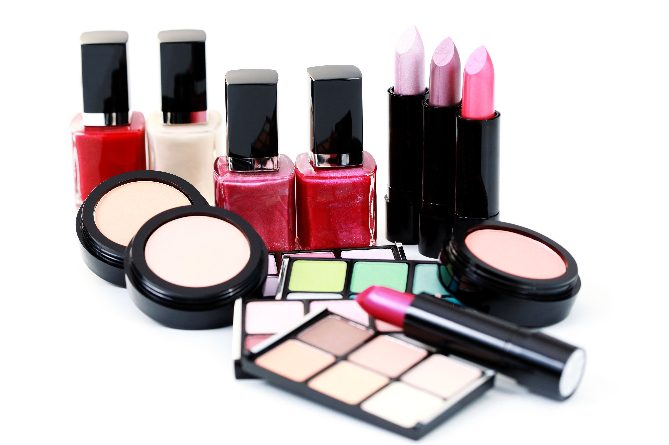
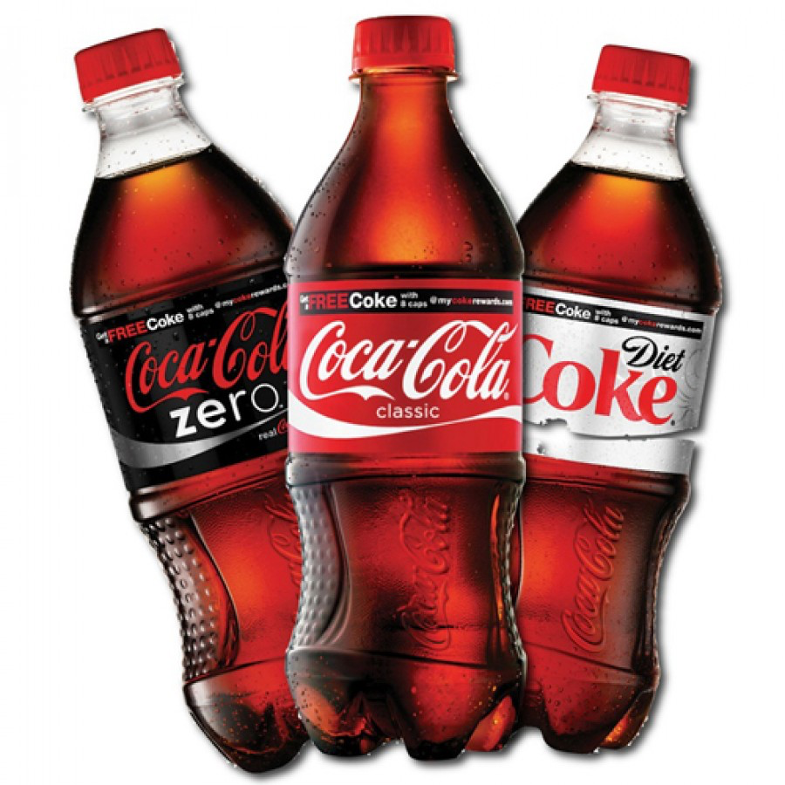
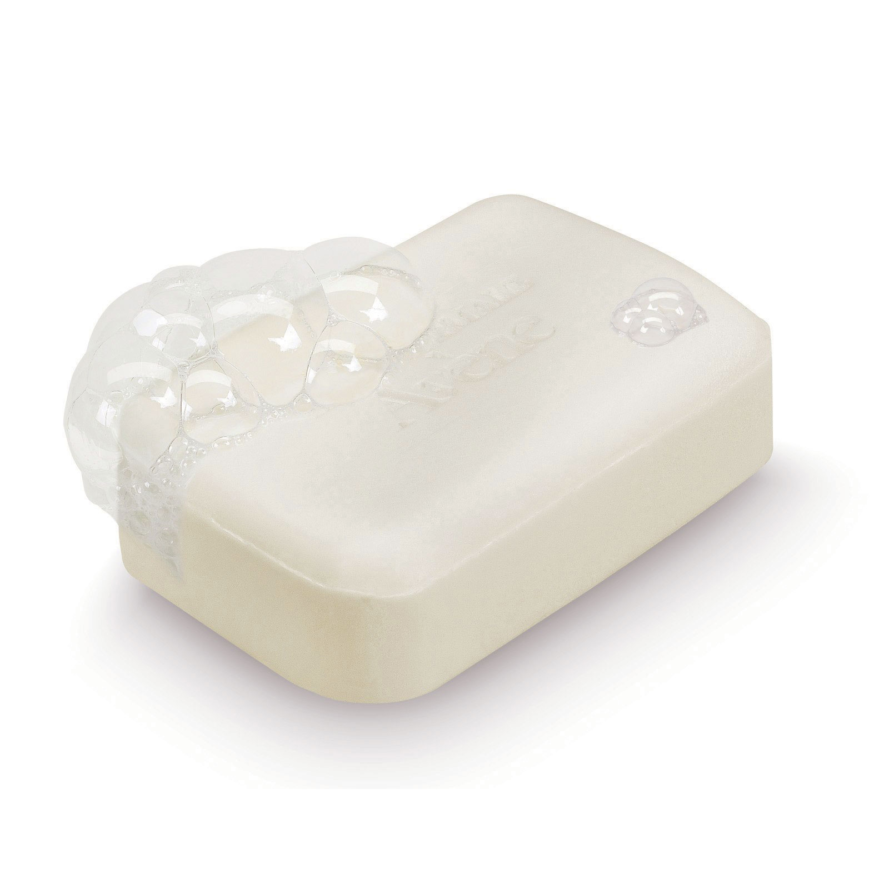
Consumer Packaged Goods
Broadly defined as a type of good that is consumed everyday by the average consumer
Soap, toothpaste, soda, snacks, clothing, cosmetics, etc.
Non-Durable Goods
High Volume, Low Margin items
Industry is valued at approximately $2 Trillion in North America
Source: Investopedia
Notes:
- Generate significant revenue from constant repeat sales – continually restock items (deodorant, laundry detergent, make up)
- Referred to as fast moving consumer goods due to their quick use and easy replacement – as a result CPG items tend to have a low cross price elasticity (or switching cost), will remain highly competitive

Slide 4
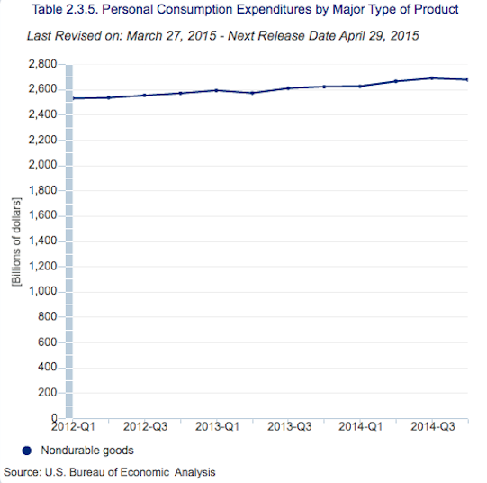
Drivers of the Industry: Consumer Spending
Notes:
Personal consumption on non durable goods is up in the last 2 years, over $2.6 Billion

Slide 5
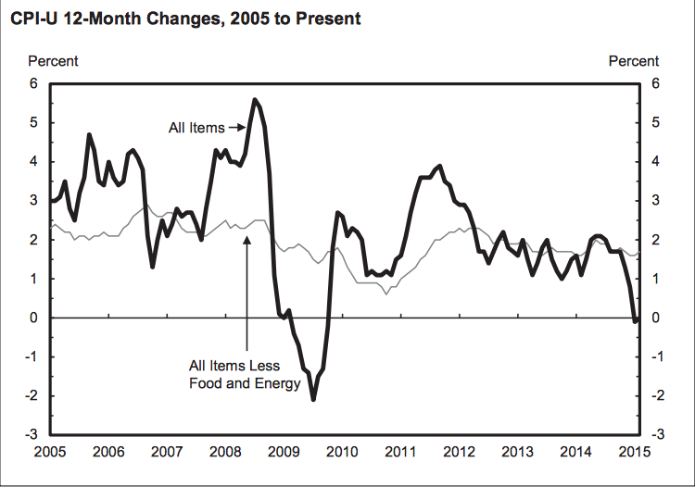
Drivers of the Industry: CPI
Source: US Bureau of Labor & Statistics
Notes:
CPI remains low for food and apparel, low and reasonable prices for these goods help sustain spending
Unadjusted 12-month ended Feb 2015 CPI for Food: 3.0%
“ “ for Apparel: -0.8%
- Overall CPI at near 0 currently

Slide 6
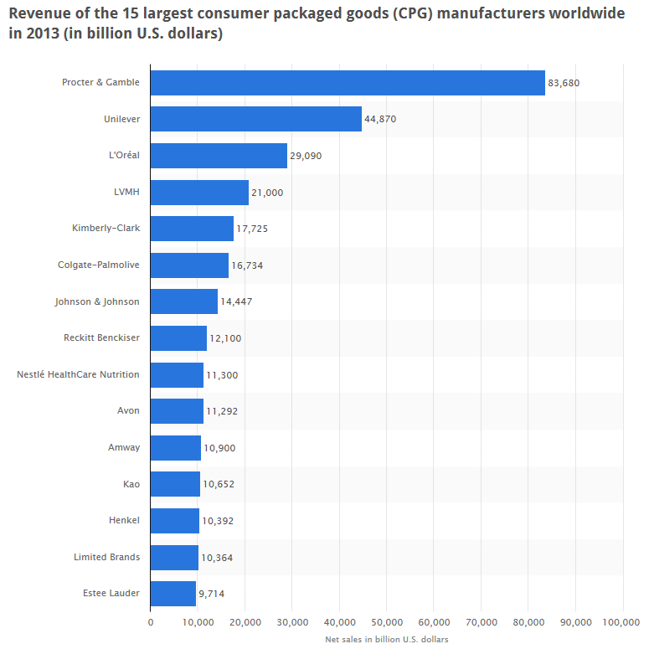
CPG Industry
Source: Statista
Notes:
Largest players are P&G, Unilever, and L’Oreal as of 2013
Top 3 had over $150 Billion in sales
Overall still quite competitive as there is a sizable portion of sales available for even the smallest players

Slide 7
CPG Industry
Notes:
- Top 3 players control 50% of the CPG market

Slide 8
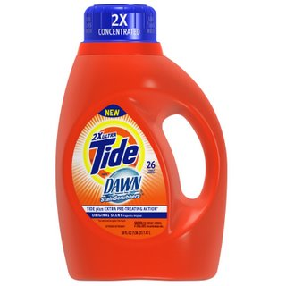
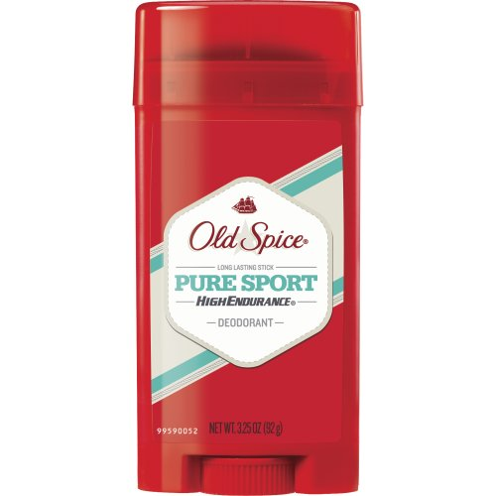
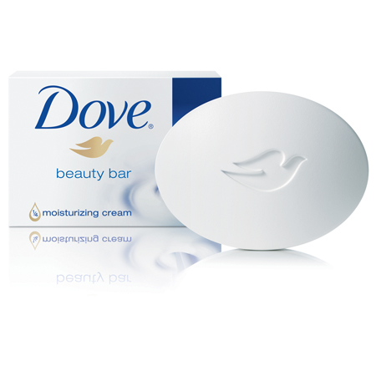
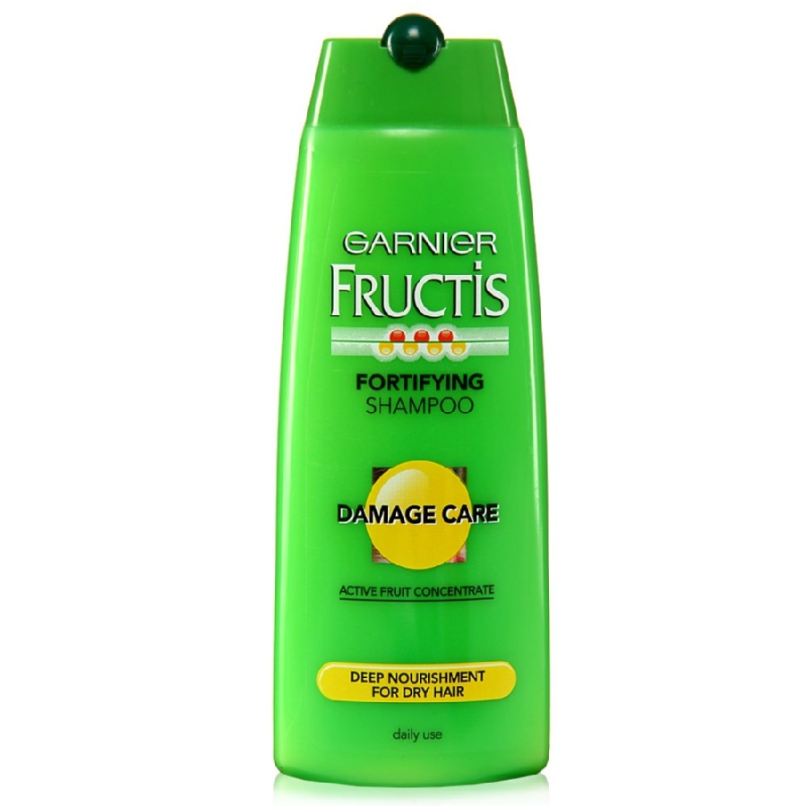
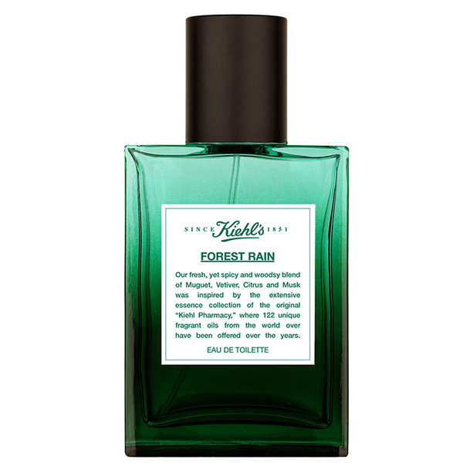
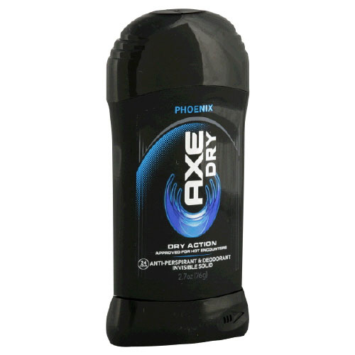
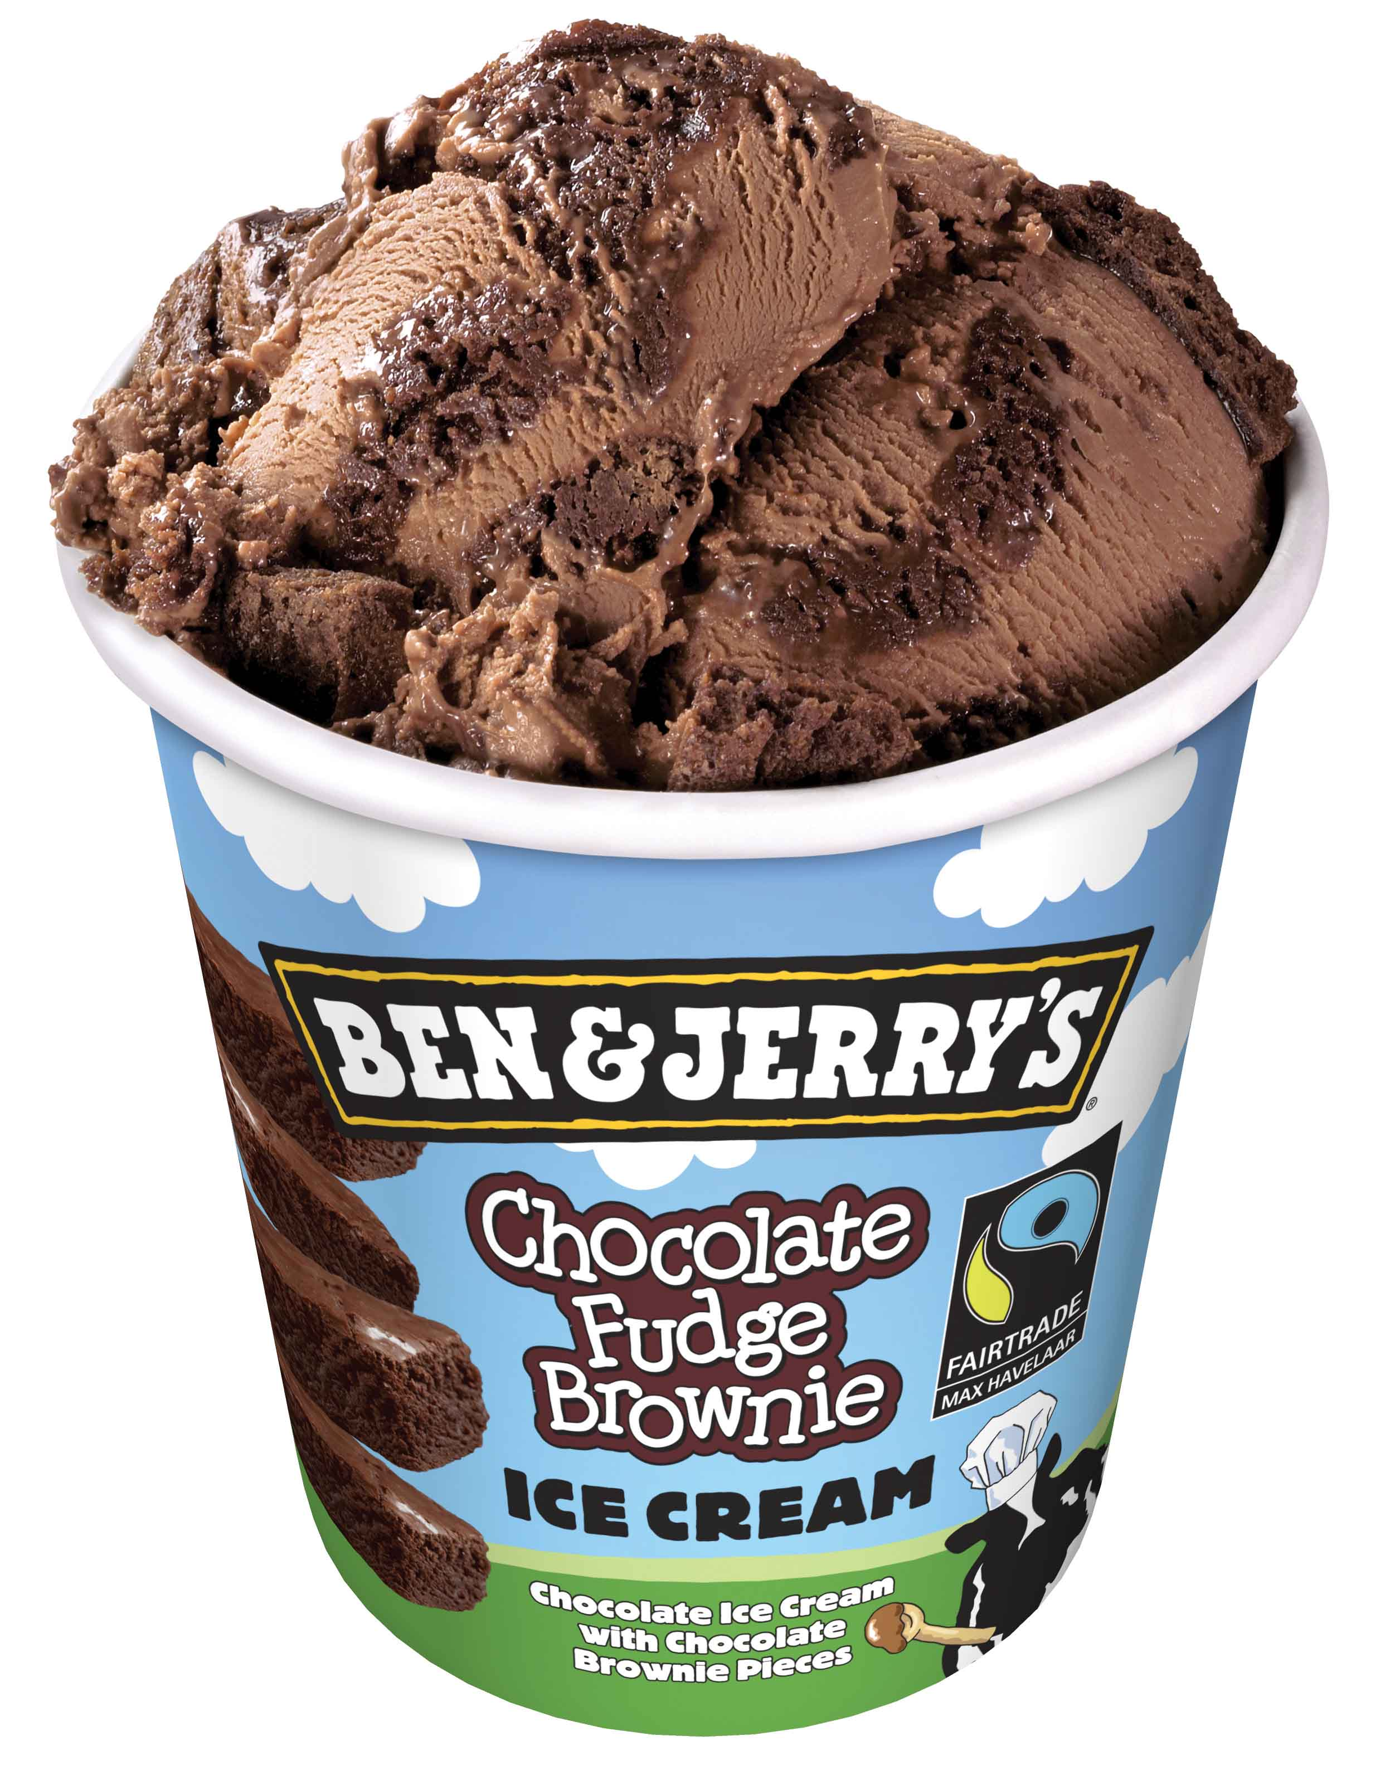
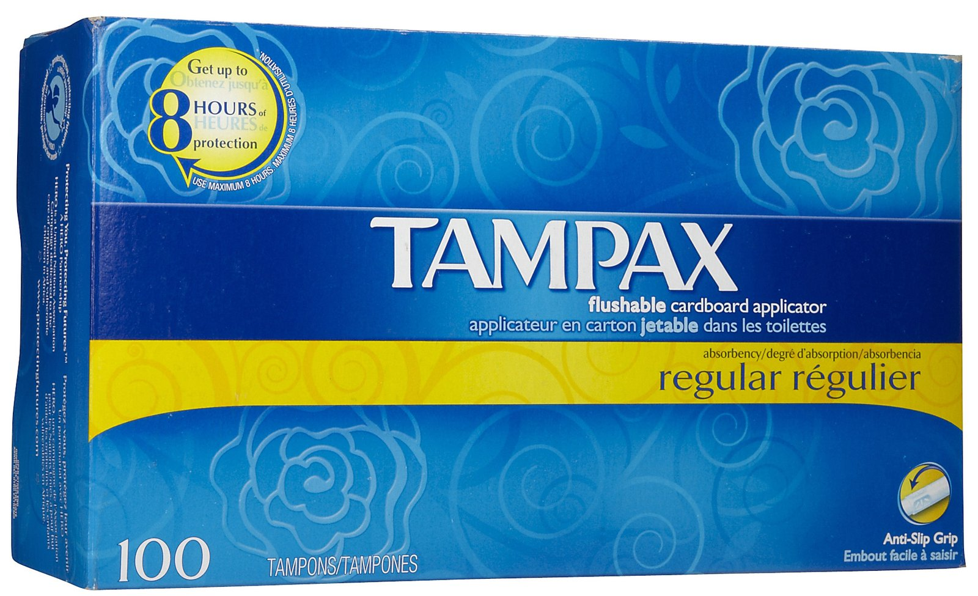
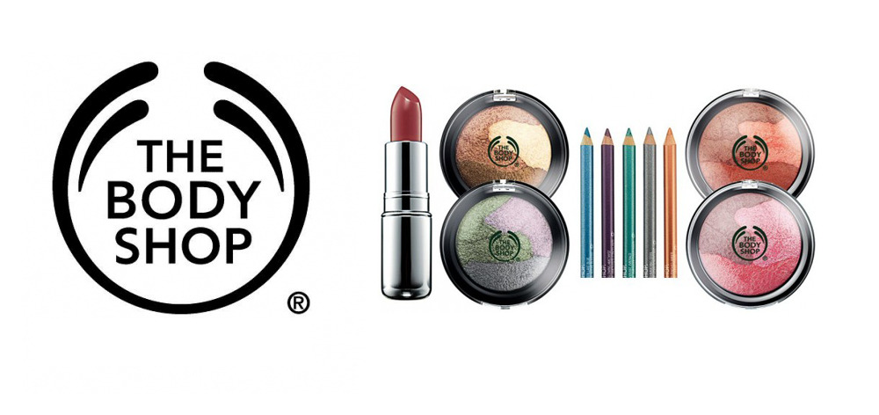
Top 3 Players
P&G
Unilever
L’Oreal
Notes:
Large holding companies dominate market share with personal care, home cleaning, and food and drink

Slide 9
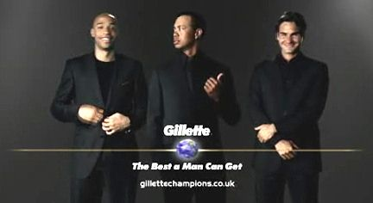
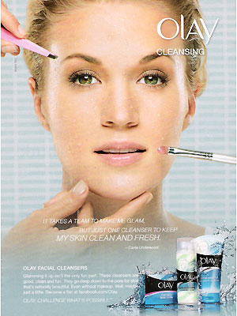
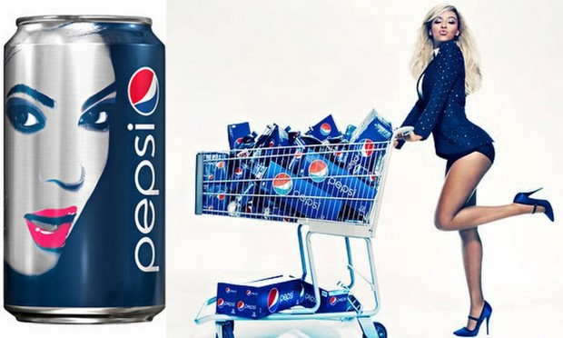
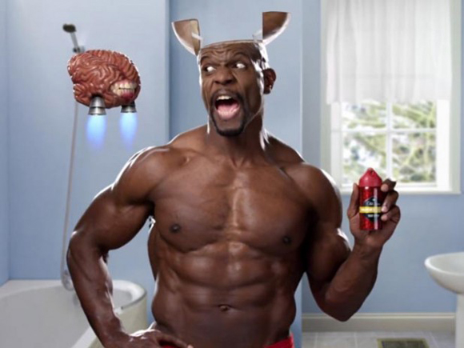
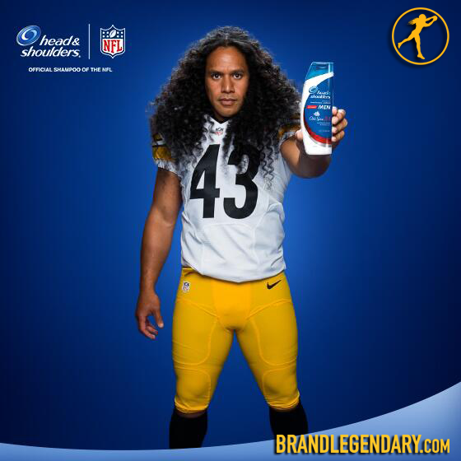
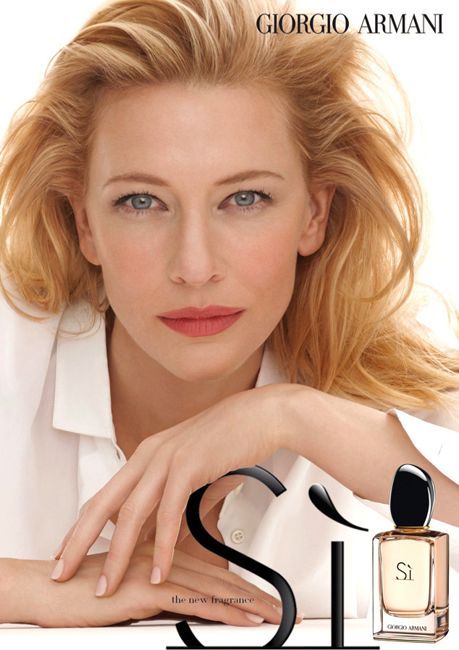
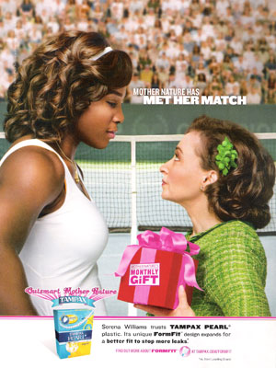
CPG Advertising: Celebrity Endorsement
Notes:
- Ad’s for these products often employ celebrity exposure to signal best products used by the rich and famous, positive product experience, credibility

Slide 10
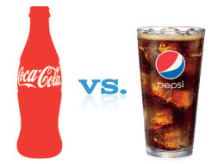
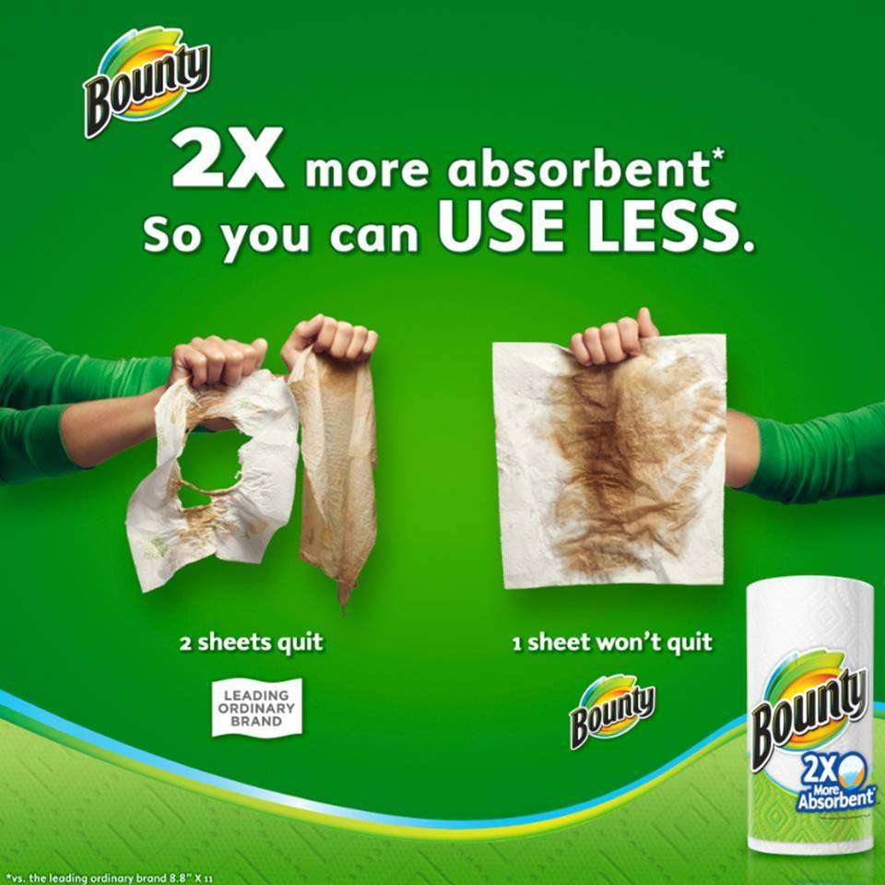
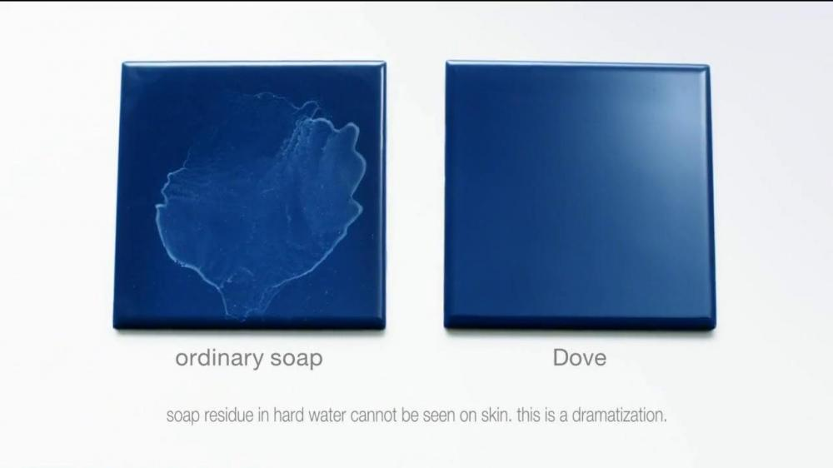
CPG Advertising: Comparative Ads
Notes:
Very few differentiating factors between certain products expect marginal quality and effectiveness, need to signal this to audience
Build brand equity
Establish brand as the leader

Slide 11
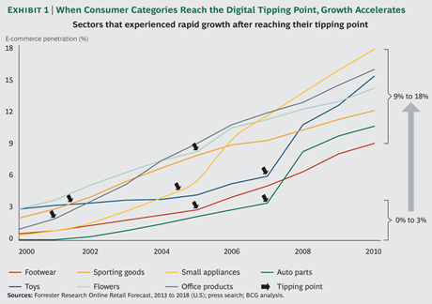
Recent Trends in the CPG Industry
Notes:
Competition in CPG is largely being driven by the emergence of digital technologies that allow consumers to have more convenient access to goods and purchase them in a new way
o The way of the future is via online purchasing and marketing, pioneered by the likes of Amazon, now many start-ups are establishing themselves in the online space such as Blue Apron and Dollar Shave Club
o Clearly, those who have a strong social media presence, a popular website and an easy-to-use mobile application have been able to gain market share in the competitive niches within CPG
- Before these companies implemented a digital platform, their growth was slow and stagnant, only accelerated after hitting the “digital tipping point” - specifically CPGs

Slide 12
The Soft Drink Industry
Notes:
Brands
Marketing

Slide 13
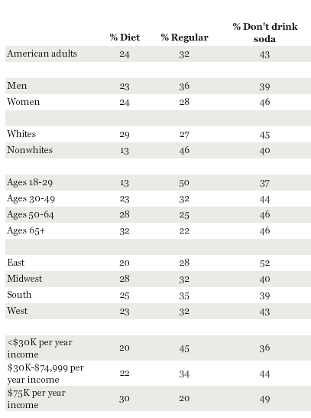
The Soft Drink Industry
American Soda Drinking Habits
Soft Drink
A carbonated, nonalcoholic beverage
Target Customer
Youths
Minorities

Slide 14
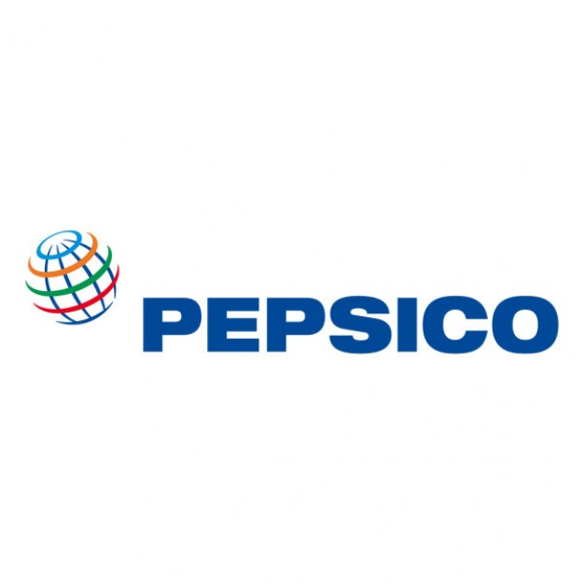
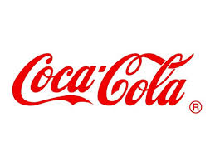
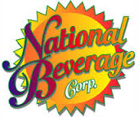
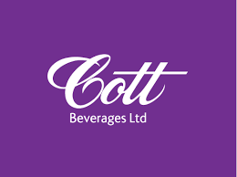
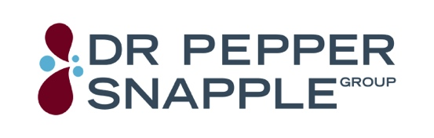
Major Players
Notes:
Target Customer, Revenue, History?
Youth and Minorities (other demographics)
$60B annual sales
1893: Pepsi
1886: Coke
1885: Dr. Pepper
1952: Cott
1985: NBC

Slide 15
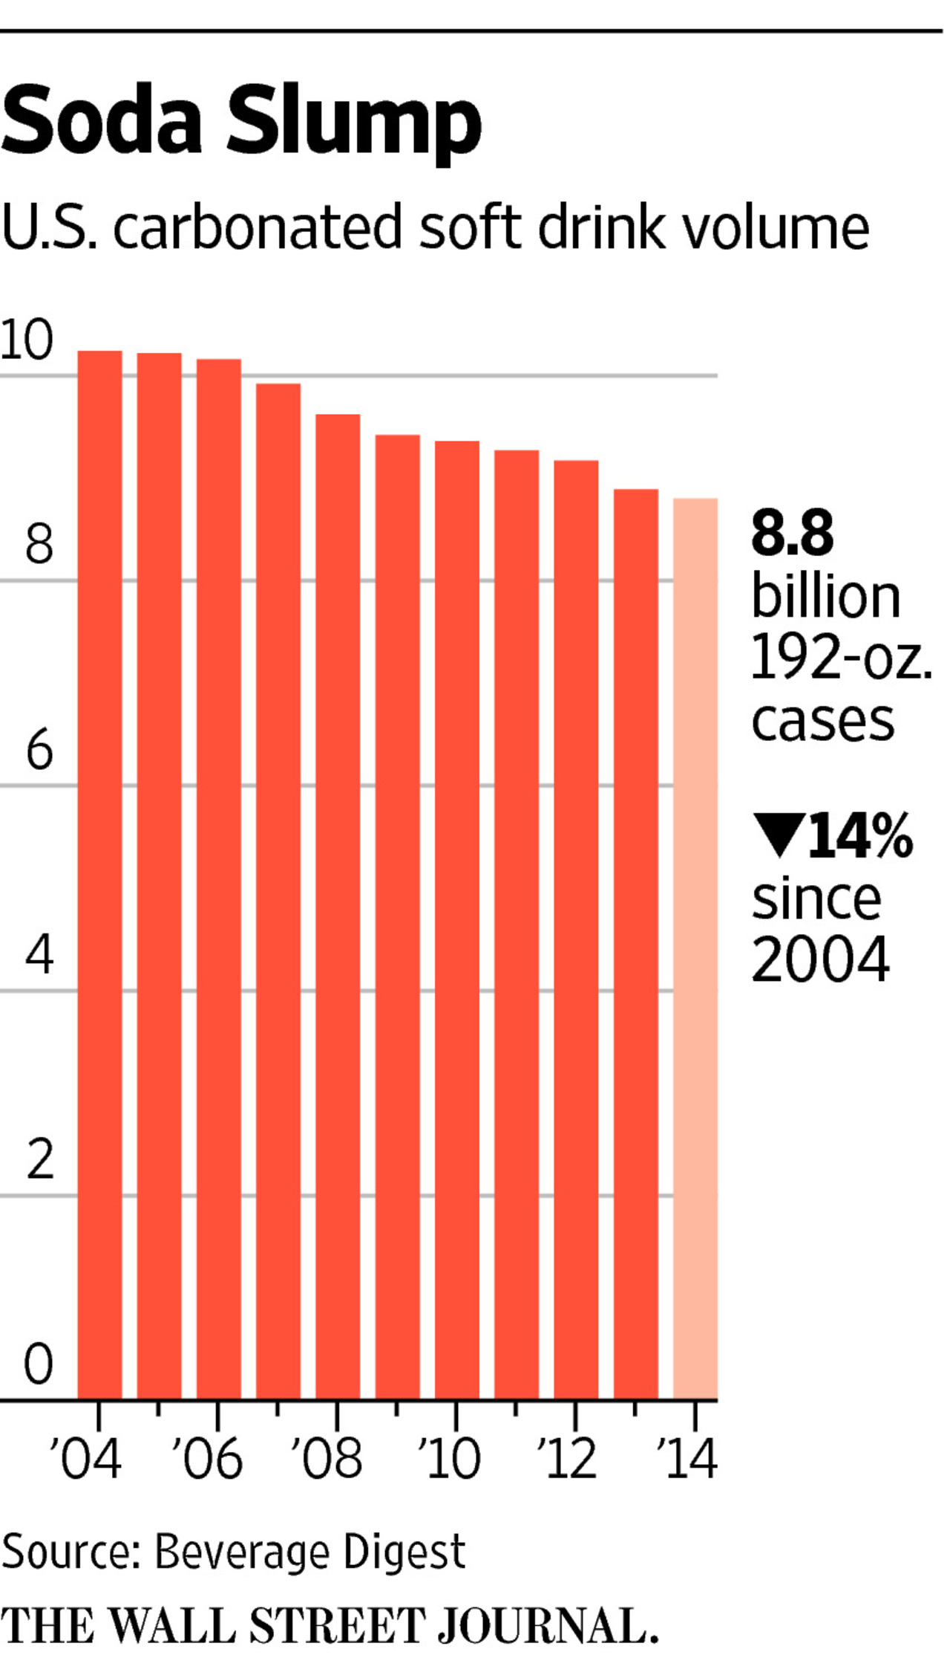
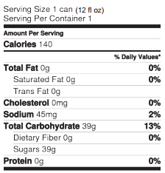
Soda Industry Trends
Decreasing Industry
Health Trend
Sugar Content
Calories
Notes:
Talking Rain
Sales down 15% since 98, Volume down 14% since 04
Men: 150 calories per day (37.5 grams or 9 teaspoons).
Women: 100 calories per day (25 grams or 6 teaspoons).
132.5 calories just from added sugar
Based on these trends, there has been a push to lower calorie consumption in America by 20% by the year 2025.

Slide 16
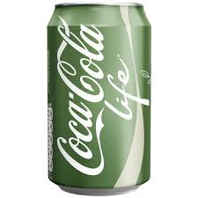
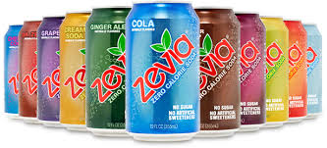
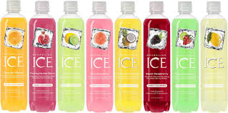
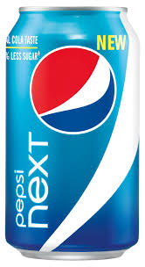
Health Innovations
Notes:
Zevia: 0 calories, 0 sugar → uses Erythirol as sugar (tastes same, no calories)
Sparkling Ice: uses juice as flavor → no calories or sugar, include vitamins
Coke Life/Pepsi Next → less calories and less sugar, but because of the distorted taste, not doing well in the market, especially US

Slide 17
Major Players
Soft Drink Market Share
C4: 91.1%
HHI: 2864
Highly Concentrated
High Barriers to Entry

Slide 18
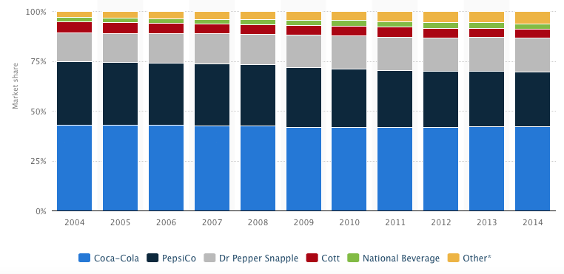
Industry Market Share
Soft Drink Market Share 2004 – 2014
Dr. Pepper Snapple taking Pepsi market share
Other: 114% increase
Notes:
Coke consistent, Pepsi losing to DPS
Pepsi: 31.7 → 27.5 (13.3% decrease)
DPS: 14.5 → 17.1 (18% increase)
Cott, Coke and NBC same
Historically, the soda industry was a very mature market. Consequentially, Coke and Pepsi were competing over the
Shrinking market, predominantly still battling over the same consumers as opposed to trying to regain the ones they are losing due to health concerns.

Slide 19
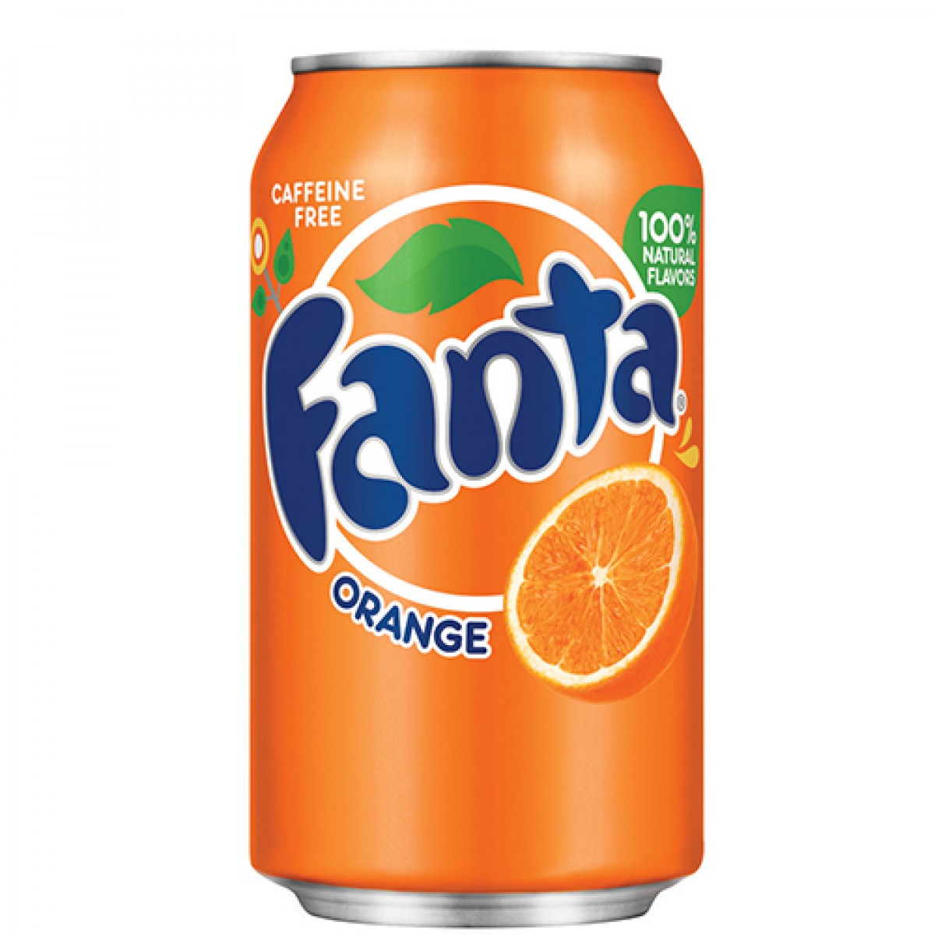
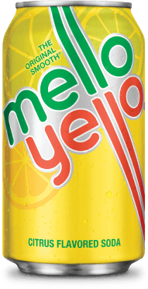
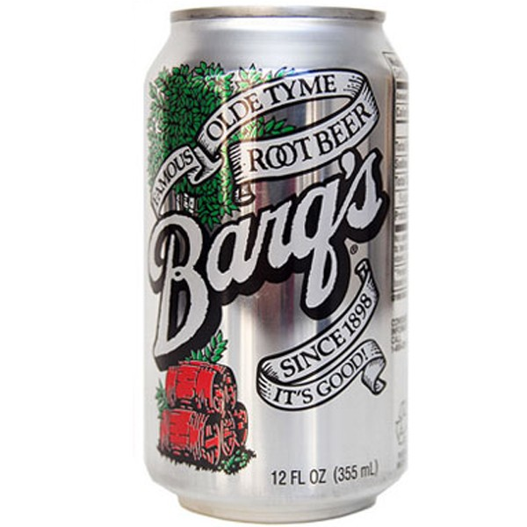
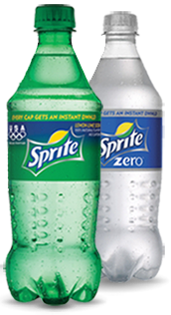
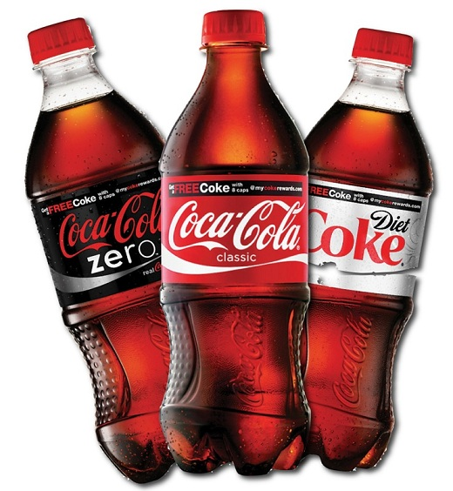
History: 1886
Stock Price: $40.74
Market Cap: $177.8B
Notes:
Stagnant → same YOY
Mainly advertise soda
Healthy: dasani, odwalla, smartwater, orange juice, fuze tea, honest tea

Slide 20
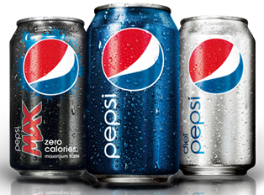
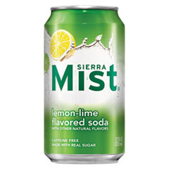
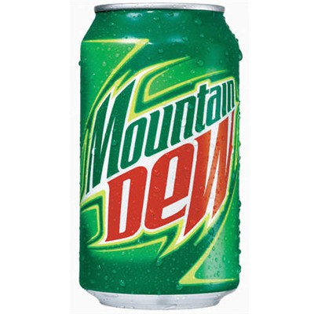
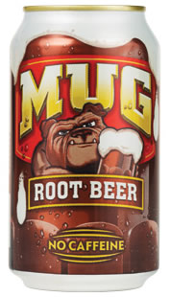
History: 1893
Stock Price: $96.91
Market Cap: $141.61B
Notes:
Growth → up 15%***
Fun for you, Good for you, Better for you
Food to go along with Soda

Slide 21
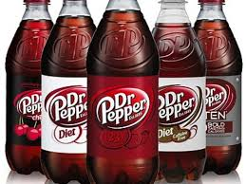
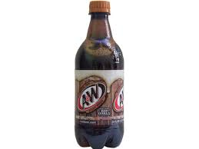







History: 1885 (2008)
Stock Price: $78.62
Market Cap: $15.05B
Notes:
Constant growth → 51.68 (up 52% YOY)
Exclusively drinks: healthier options (snapple – health conscious)

Slide 22





Industry Advertisement
Reduce calorie consumption by 20% by 2025
Notes:
Based on these trends, there has been a push to lower calorie consumption in America by 20% by the year 2025.
Marketing, packaging, products
Combative ads → industry ads
https://www.youtube.com/watch?v=Lylc4Yp0TPM

Slide 23
Coke vs Pepsi
Notes:
Brands
Marketing

Slide 24


Cola Wars
Notes:
So now we are going to take a step back and view the progress of these two giants over their storied history. With Coke and Pepsi combining to own over 70% of the industry, to study the strategies of the industry, we will be looking at these two dominant brands in soda and their strategies in the “Cola Wars”.

Slide 25


Primary Product Offering
Pepsi vs Coca-Cola Classic
Notes:
Since their conceptions in the late 19th century, each company has developed diverse product portfolios. However, for the sake of depth of analysis, I am going to focus on the two flagship brands, Pepsi as their standard Cola, and Coca-Cola Classic. These are the two products they began with and still exist today, and they also represent the majority of each companies sales.

Slide 26

Creative Ideology
“Coke is timeless, Pepsi is timely.”
Notes:
Looking at what creative strategies have been used since then, I believe This quote from Pepsi’s current Chief Creative Officer perfectly sums up the two ideologies:
“Coke is timeless, Pepsi is timely”
The overarching theme of the two companies is that Coke represents permanent happiness while Pepsi is all about excitement.

Slide 27


Pepsi’s Ad Ideology
Comparative Advertising
Constantly comparing itself to Coke, especially on taste and lifestyle
Youthful Exuberance
“Come Alive”
“Next Generation”
“Live for Now”
Celebrity Endorsements
Michael Jackson
Madonna
Ludacris
Nicki Minaj
Beyonce
Notes:
Looking more at this timely approach, here is Pepsi’s Advertising ideology.
Firstly and most notably, Pepsi has a history of intense comparative advertising. The most famous instance is the Pepsi Challenge blind taste tests in 1975, but they are constantly comparing themselves to Coke, trying to win over consumers through marginal taste difference and lifestyle associations.
This lifestyle is the youthful excitement. Words such as “Come Alive”, Next Generation, and Live for Now have all been used in their slogans, really focusing on the exciting lifestyle surrounding their drink.
To reinforce this, they have a long list of celebrity endorsements. Michael Jackson, Madonna, Ludacris, Nicki Minaj, Beyonce, and many more have all served as spokesperson for Pepsi over the years. As we discussed in class, this can be effective in drawing attention to the brand and associated “personality” of the brand. However, it can, and has backfired, on Pepsi in the past.

Slide 28


Coke’s Ad Ideology
Never compare down to Pepsi
“The Original”, “Real”, “Classic”, “America’s Choice”
Family values, meaningful friendships, and sharing happiness
Notes:
Switching over to Coke, the little guy always compares to the big guy, but not the other way around. Why? Because Coke gets to market itself as The Original, The Real Thing, Classic, and America’s Choice. They were the first movers, they get to set the standard, and they are always appealing to this classic appeal, which resonates with all age groups.
They do this by constantly emphasizing happiness through meaningful relationships with family and friends. They run ads that don’t cause the same excitement like Pepsi, but instead evoke contentment. Satisfaction with your life and the people in it. True happiness that you want to share.

Slide 29

Strategic Commonalities
Commonly market the lifestyle, not the product
Both advertise flagship brand 70% of the time in comparison to their other soda alternatives (Coke Zero or Pepsi Max)
Product placement, primarily in movies
Sponsorships:
Coca-Cola: American Idol, Olympic Games, NCAA
Pepsi: Super Bowl Halftime Show, NBA, NFL
Notes:
Depsite their differences, they do have similar strategies in several ways. In modern years, both use persuasive ads since they are experience goods, so they predominantly air ads that are revolving around lifestyle more than product. Very rarely, if ever, will you see an ad outlining the product specs of either drink, but instead you see commercials of the environments you should drink in and who you drink them with.
Also, amongst all of the beverages that each company offers, each uses 70% of their TV budget to advertise their flagship brand. That is important as it builds the brand equity as a whole in combative terms against the other instead of just the singular benefits of say Coke Zero of Pepsi Max.
Lastly, both brands use product placement and sponsorships. Pepsi just scored the NBA, which is a huge stride.

Slide 30

“New Coke” Case
Pepsi Challenge advertising campaign
Spurred huge outcry from Coke drinkers and distributers (particularly the Southeast)
Over 400,000 calls and letters were received by the company
Difficulty having to promote and sell a drink that had long been marketed as "The Real Thing", constant and unchanging, and now it had been changed.
Within 3 months of changing to “New Coke,” it was reverted to Coca-Cola Classic
Extreme brand loyalty
#3 brand value global ranking at $79.2 billion
Notes:
Combining some of these strategies, I looked into the New Coke case. In short, the Pepsi Challenge had Pepsi winning in blind taste tests, and this caused Coke to change their famous formula to make it sweeter and win taste tests.
Coke lovers felt betrayed, and they responded in swarms. It only took 3 months for Coca-Cola to re-release the old formula.
"The simple fact is that all the time and money and skill poured into consumer research on the new Coca-Cola could not measure or reveal the deep and abiding emotional attachment to original Coca-Cola felt by so many people.”
Extreme brand loyalty has been the main driver of Coke’s success. This has been helpful in maintaining market share over Pepsi, but it is also granting them more inelastic consumers, defending them against sharper declines in sales as they have gradually increased their prices due to reduced demand.

Slide 31

Social Media Activity
Notes:
But before we get into that, I want to go over their most recent strategies, social media. Although less significant in terms of ad expenditures, they are big focuses for both companies as they move forward. Social media allows for cheaper, higher frequency, and more targeted advertising, making it highly attractive.

Slide 32


Coke on Social Media
Notes:
First of all, Coke produces an incredible amount of content online, as we will see over the next several slides. They have made a big push on social media over the past 3 years under what they call the 2020 Initiative Strategy. The objective is to create what they call “liquid,” meaning that it is “so contagious that they cannot be controlled,” and “linked” meaning that it is perfectly woven with their business interests, brands, and consumer interests. Tell stories, promote conversations, and act and react to those conversations at all times.
Coke has made a severe, concentrated effort to not only create content that aligns with their ideology, but to consistently and actively engage consumers throughout the lifespan of content.

Slide 33

Twitter Engagement (2013)
Notes:
Coke has the most Facebook, Twitter, and Instagram followers; however, that isn’t the interesting part. As you can see, Coke clearly is adhering to the ideology I just mentioned. 99% replies to other users… that is ridiculous, especially in view of how many tweets were analyzed. However, Coke does have less retweets and favorites, indicating quantity over quality, apparently.

Slide 34
YouTube Activity
Notes:
Similarly, this chart shows the Youtube story between the two brands. I know it is a bit hard to read, but the main takeaway is that while Coke dominates in the quantities, Pepsi still seems to be producing more popular content. Pepsi has more subscribers, more average views per video, and likes, which indicates that Pepsi is better resonating with the younger demographic that largely comprises social media, which is exactly what they want to do.
Average views per video:
Coke – 122,943
Pepsi – 216,801

Slide 35

Pepsi Challenge 2015
Pepsi just launched a global social media and social responsibility campaign, enlisting the help of numerous world-famous celebrities.
Notes:
But most interestingly, last month, Pepsi just launched their year long latest social media program. Giving a nod to the 40 year anniversary of their famous Pepsi Challenge that we already talked about, Pepsi is now launching a global social media and social responsibility campaign, enlisting the help of numerous world-famous celebrities.

Slide 36

#PepsiChallenge
Notes:
Essentially how it works is that the Pepsi celebrities (Usher, Serena Williams, James Rodriguez, and Usain Bolt) are going to issue various challenges for anyone and everyone to complete, and every the #PepsiChallenge hashtag is used, Pepsi will donate $1 to Liter of Light USA, Inc. a charitable organization that brings light to those in need.
So this is yet another step in the right direction for Pepsi as they are able to precisely attack their target market on social media with exciting, youthful, celebrity driven content. It is hard to measure the effectiveness of these efforts in terms of sales, of course, but it is very effective in adhering to and promoting their brand image of youthful excitement.
With that said, with social media efforts in full swing, TV is still the largest ad expense for Coke and Pepsi alike, so Veronica is going to analyze the TV data for each company.

Slide 37
Expenditures Ad-to-Sales Ratios (2014)
CPG Average Ad-to-Sales Ratio %
6.3%
highest of all industry sectors, next highest being Construction and Real Estate at 3.6%
Coca-Cola
7.6%
Pepsi
5.8%
Notes:
Now I want to briefly look at advertising expenditures. As you can see Coke has a higher ratio than Pepsi and the CPG average, and the CPG is the highest in all industries, so Coke is spend a lot by any metrics. Pepsi, although lesser, is still spending a lot. These high numbers in the CPG industry are due to the low differentiation of products and high dependability on brand equity and frequency of advertising.
Coke 6.9% (2013) -> 7.6% (2014)
Pepsi 4.9% (2014) <- 5.8% (2013)
https://saibooks.com/index.php?option=com_content&view=article&id=60&Itemid=61

Slide 38

Notes:
US only
Pepsi currently has the lead as far as gross expenditure in the US, but both brands are increasing their advertising budgets moving forward. Coke has stated that they plan on increasing their marketing spending by $1 billion by 2016 to keep up. This is due to the confidence that their marketing strategies are effective in creating sales and maintaining brand equity.

Slide 39
Notes:
Global
Now looking at the parent companies’ global ad expenditures by medium, again you can see that Pepsi is currently dwarfing Coke, but this is because PepsiCo has such a huge portfolio. But the reason I wanted to show this is to note that bulk of each brands’ expenditures are put towards TV, and Veronica will dive deeper into that in just a bit.

Slide 40
Data Analysis
Notes:
Brands
Marketing

Slide 41
Network Choices for Advertising

Slide 42
Network Choices for Advertising
Notes:
Buying more expensive shows on CBS and NBC Buying less expensive shows on CW and ABC

Slide 43


Pepsi Sports Takeover
“We’re not in the business of partnering with one-time sporting events. We partner with sports leagues, teams and athletes to drive sales every day of the year.”
“We are the ultimate partner for a league, team or athlete. They have a need for partners that can help enhance the fan experience, support youth programs and other initiatives, and we can do all of that.”
- PepsiCo. statement
Pepsi has positioned itself as the brand to control advertising and promotion for all four major North American professional sports leagues: NBA, NFL, MLB and NHL
Notes:
Recent Developments (April 13, 2015):
The National Basketball Association is trading Coke for Pepsi. The league said Monday that it's struck a new marketing partnership with Pepsico, ending a 28-year partnership with Coca-Cola.
Consequences:
Pepsi is in control of league-wide advertising and promotion.
helps Pepsi to clearly position itself as a brand that is consumed around sports.”
Separately, Coca-Cola announced Monday that it signed a multiyear partnership with the U.S. Soccer Federation and Major League Soccer.

Slide 44
Coke Ad Spend per Number of Ads
$ in 000,000’s
Advertising Strategy:
High advertising frequency in February, May, September, and December.
Most expenditure on advertising in January, March, May, December.
Most expensive advertising on Sports (Football) and Reality (American Idol).
Notes:
2 8milliondollar Super Bowl ads in February Spent 4.7 million on American Idol in March (and 2 $1.08 million ads in January)

Slide 45
Pepsi Ad Spend per Number of Ads
Advertising Strategy:
High advertising frequency in January, March, August, and December.
Most expenditure on advertising in January, March, May, December.
Most expensive advertising used on Awards and Sports genres, predominantly on NBC.
$ in 000,000’s
Notes:
In January, bought $4.7 ad for Grammy Awards
In February, bought Super Bowl ad $4.2 million
American Country Countdown Awards in December – 8.4 million
Academy Awards in March ($3.5 million ad) NBC Sunday Night Football in November and December

Slide 46
Pepsi vs Coke: Average Ad Spend per TV Genre
In Data: Coke has 302 ads, Pepsi has 209 ads.

Slide 47

Attractiveness of Portion Control
"Typically, in the industry when there's been portion-control packages, the message has been functional in nature. We want to take this to an emotional place. It's not about it being only 100 calories.”
- Seth Kaufman, VP-marketing for colas at PepsiCo.
After rising by 34% in 2013, PepsiCo’s mini can business also increased by 24% through June 2014 in the U.S.
According to Euromonitor, while sales in the overall U.S. CSD market remained flat last year, mini can sales rose 3%.
Notes:
https://www.youtube.com/watch?v=OCXr7ECpGQg
2013-first time to reshape 20 oz. bottle
The smaller 7.5-ounce mini cans have higher pricing per ounce, as compared to the 20- and 24-ounce packages, thereby boosting net pricing for companies.

Slide 48
Ad Frequency per Ad Length
For this data:
253 15-second ads
822 30-second ads
24 60-second ads
Notes:
Overwhelming popularity of 30-second ads (60-seconds used for special occasions, 15-seconds serve as ‘filler’/’reminder’)
Similar trends in 15-second ads and 30-second ads among Coca-Cola Classic, Dr. Pepper, and Pepsi. Trend to advertise most important ‘regular/original’ products first and foremost, with diet versions and variations later.
Coca Cola is constantly a leader in the frequency of advertising – has $$ to spend and is able to buy more advertising time. What is interesting is Dr. Pepper’s advertising through the more expensive 60-second ads.

Slide 49


Regression of POD Data
Y = the position of the ad within the break
Z = the length of the break (number of total positions within the break)
Concentration of the Data

Slide 50
Position of Ad within Commercial Break
Notes:
Hypothesis:
- Advertising will be more concentrated at the earliest positions within ad breaks, just after the program breaks for commercials.

Slide 51
Ad POD Regression for all Soft Drinks

Slide 52
Investment & Recommendation
Notes:
Brands
Marketing

Slide 53
Investment
Coke - HOLD / UNDERPERFORM
Strong brand image, global presence
Brand loyalty remains with soda
Holdings include exclusively beverages, not established in snacks
Safe revenue stream, however, soda consumption is decreasing in the US due to health consciousness
Pepsi - BUY
Stable 5 year earnings
Recent deal with NBA makes Pepsi exclusive basketball brand
Larger product mix, more ability to innovate
Example: Frito-Lay products partner with Taco Bell for new menu items, 7-Eleven, Papa Johns
Notes:
Coke - HOLD / UNDERPERFORM
Strong brand image, global presence
Brand loyalty remains with soda
Holdings include exclusively beverages, not established in snacks
Safe revenue stream, Quick Ratio a little over 1, safe however soda consumption is decreasing in the US due to health consciousness
Pepsi - BUY
Stable 5 year earnings, and higher, Pepsi overtook Diet coke as the #2 soda in US
Recent deal with NBA makes Pepsi exclusive basketball brand, heavy stronghold in sports - Gatorade
Larger product mix, more ability to innovate
Example: Frito-Lay products partner with Taco Bell for new menu items, 7-Eleven, Papa Johns
Continually increasing dividend
Seeking Alpha cites 5-yr EPS growth at 6.77%, compared to Coke’s 4.87%
Both have comparable PE ratio, very low beta, Pepsi EPS is nearly 4 times that of Coke (0.97 vs 0.25)

Slide 54
Investment
Notes:
Both relatively stable, Pepsi increasing slightly and much higher due to broader product offering
Coke revenue is actually decreasing

Slide 55
Recommendation
Coke should redistribute marketing budget to put an emphasis on their healthier existing products in addition to classic Coke
Orange Juice, Tea, Water, Mixify campaign
Increase of marketing budget signals an intention continue to push existing brands globally
Pepsi should also pursue health conscious customers and focus on developing their healthier brands
Quaker, Baked Lays, Propel

Slide 56
Thank You
Questions?

